Slide 1
CONSULTIME
A Cross-Platform Consultation and Appointment Management System for Mahayag National High School
Presented by: Philipp Edward Sapalicio, Ednell Sapalicio
ITE Department, Philippine College of Technology | May 2026

Slide 2
PROBLEM STATEMENT
Challenges in manual scheduling and communication at Mahayag NHS
• Uncoordinated Timetables: Relying on static lists on doors leads to appointment conflicts.
• Communication Gaps: Lack of instant notifications for sudden timetable changes.
The Scheduling friction
Academic scheduling at Mahayag National High School remains largely manual, relying on paper logbooks, physical bulletin boards, and uncoordinated verbal updates. This leads to inefficient time management, missed consultation slots, and coordination gaps.
• Security Concerns: No centralized verification process, allowing unvetted sign-ups.
• No Touch Optimization: Current systems lack mobile responsiveness, limiting accessibility.

Slide 3
OBJECTIVES
Primary and specific objectives of ConsulTime
Primary Objective
To design, develop, and implement ConsulTime: a real-time academic consultation and appointment management system for Mahayag National High School to digitize and streamline scheduling workflows.
Specific Capstone Targets:
• Secure User Gateways: Develop secure registration and login views for Students, Faculty, and Administrators.
• Dynamic Schedule Blocks: Allow faculty members to declare, modify, and close availability hours in real time.
• Responsive Client UI: Establish a mobile-friendly appointment booking form for students.
• Account Vetting Panel: Integrate approval toggles for admins to verify faculty credentials before activation.
• Cross-Platform Compilation: Deploy system as a local-cached PWA and native Android App wrapper (.APK).

Slide 4
SCOPE AND LIMITATIONS
Technical boundaries and operational constraints of the system
Project Scope
System Limitations
• Scheduling Engine: Tracks student appointment requests and faculty responses.
• Real-Time Sync: Updates calendar states instantly across client dashboards when changed.
• Authentication Controls: Limits system read/write capabilities according to user roles.
• Administrative Vetting: Validates faculty profile registration parameters.
• No Video Calls: Stakeholders communicate inside the system but meet physically (no video frame integration).
• iOS Limitations: Mobile native compilation generates Android wrapper packages (.APK) only.
• Internet Dependency: Relies on cloud listeners and requires active connections for data sync.
• No Document Scanning: Relies on user uploads (no optical character recognition utilities).

Slide 5
SIGNIFICANCE OF THE STUDY
Impact of ConsulTime on school stakeholders
To Students
To Faculty Members
To School Administrators
• Reduces manual scheduling friction.
• Enables quick reservation of slots directly from phones.
• Keeps students updated on request statuses instantly.
• Saves time by removing manual logbooks.
• Allows setting custom consultation availability slots.
• Prevents double-booking conflicts automatically.
• Provides unified portal to audit registrations.
• Maintains verified, secure list of active academic roles.
• Saves history of consultations for research records.

Slide 6
SYSTEM ARCHITECTURE
ConsulTime's three-tier design layout
CLIENT TIER
CLOUD DATABASE TIER
ADMINISTRATIVE TIER
• Web App: HTML5, CSS3, ES6 JS.
• Android Package: Compiled native wrapper via Capacitor.
• Caching: Service Worker (sw.js) for fast assets offline reload.
• Supabase Instance: Relational PostgreSQL schema host.
• Row Level Security (RLS): Enforces access restrictions.
• Real-Time Subscriptions: Pushes database writes instantly.
• Vetting Controls: Activates pending faculty registrations.
• Telemetry Checks: Monitors database speeds and latencies.
• Version Control: Syncs version.json to reload clients.

Slide 7
DATABASE SCHEMA: USERS & AVAILABILITIES
Detailed view of the profiles and availabilities relations
Table 1: User Profiles (profiles)
Table 2: Availabilities (availabilities)
• uuid id: Primary Key linked to Supabase auth credentials.
• text role: Limits users to Student, Faculty, or Admin.
• text department: Stores academic department information.
• text id_number: University standard identification field.
• boolean is_approved: Vetting flag for faculty accounts.
• uuid faculty_id: Foreign Key pointing to profiles.id.
• int4 day_of_week: Maps recurring days from Monday to Friday.
• time start_time: Availability block start boundary.
• time end_time: Availability block end boundary.
• date specific_date: Optional single-occurrence time window overrides.

Slide 8
DATABASE SCHEMA: BOOKINGS
Transactional engine of the system
Table 3: Consultation Bookings (bookings)
• uuid student_id & faculty_id: Dual Foreign Keys referencing user profile tables to bind participants.
• date appointment_date: Calendar date of the consultation.
• time start_time & end_time: Precise timing parameters of the consultation.
• text purpose: Qualitative reason block filled out by the student.
• text status: Booking state constraint strictly restricted to Pending, Approved, or Rejected.
• text faculty_notes: Optional feedback block for instructors to write resolutions.

Slide 9
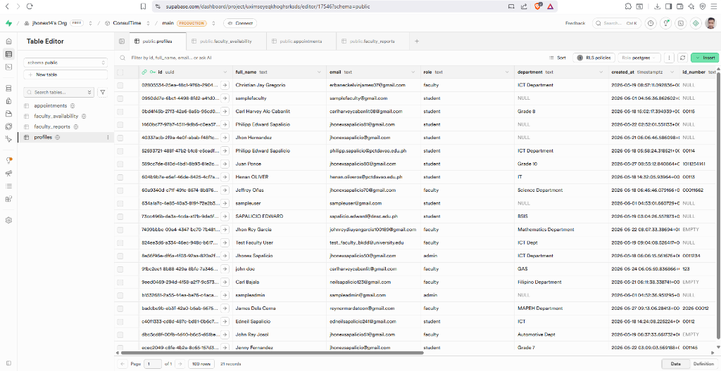
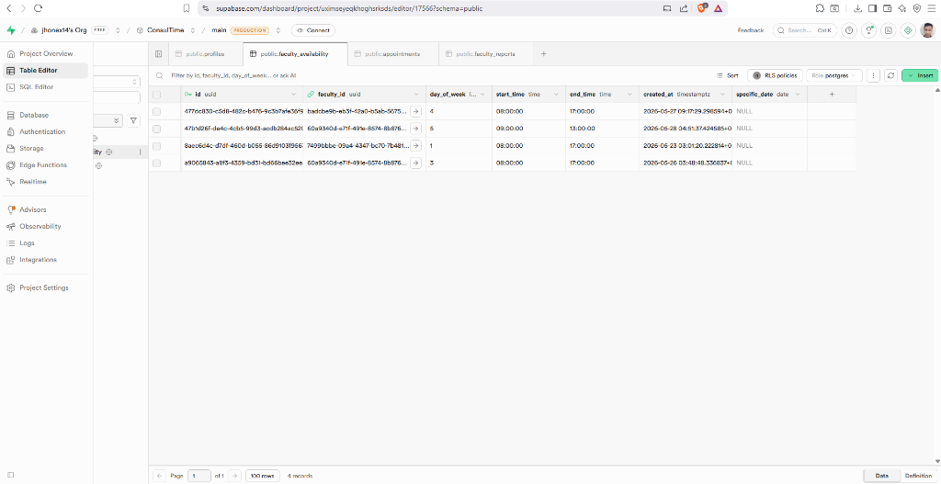
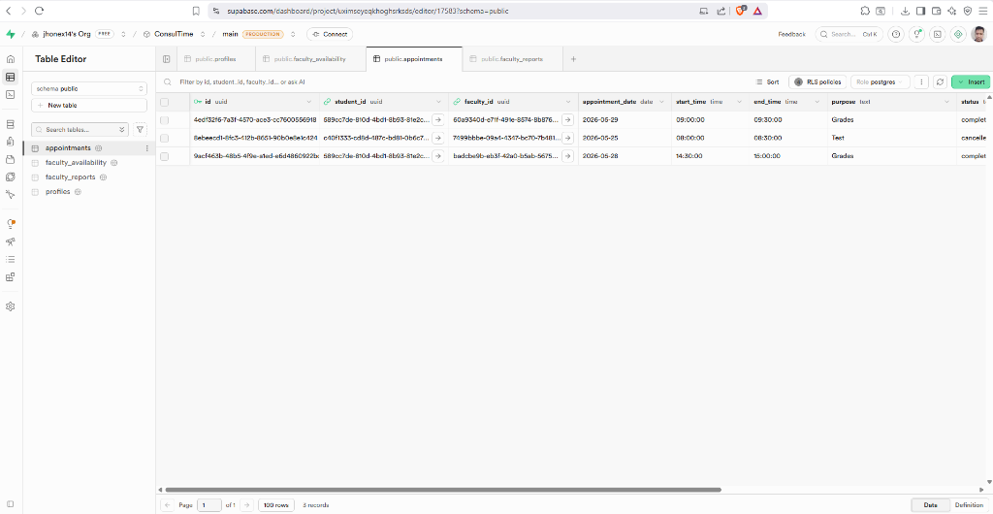
DATABASE RELATIONAL TABLES
Live database table records hosted on Supabase Cloud
Supabase profiles schema showing role distribution, credentials mapping, and user vetting statuses.
Faculty availability slots table with dynamic timestamps, day-of-week markers, and recurring boundaries.
Transactional bookings junction table mapping student/instructor requests and status state transitions.

Slide 10
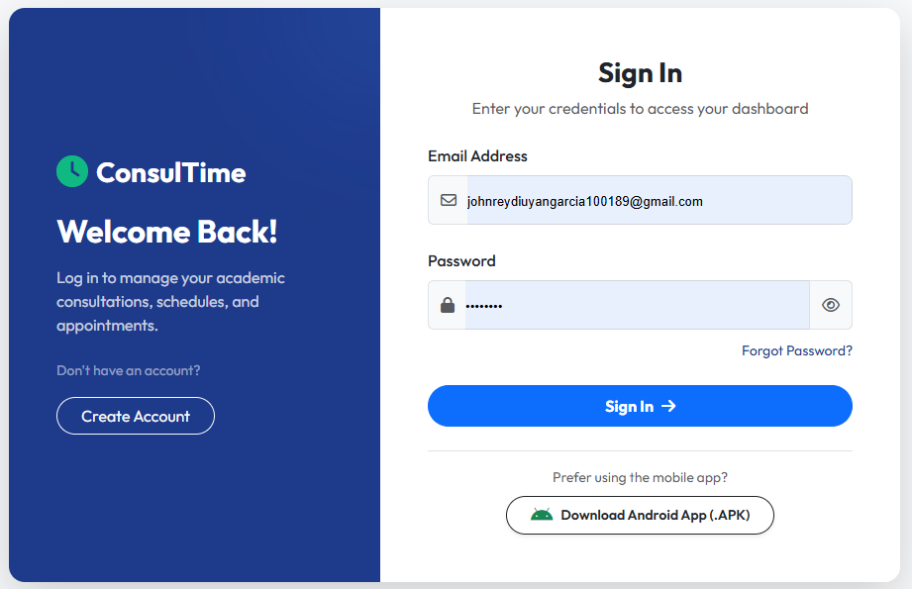
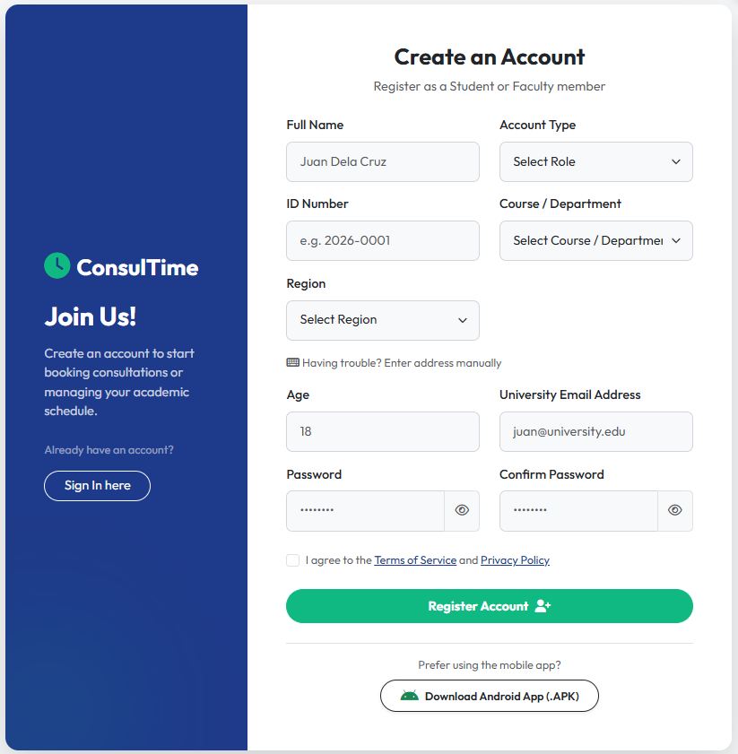
SYSTEM SHOWCASE: ACCESS & REGISTRATION
Secure user gateway and sign-up pipeline views
Figure 1: Login interface. Routes user role to Student, Faculty, or Admin dashboard automatically.
Figure 2: Registration console. Restricts emails to school domains and collects faculty verification uploads.

Slide 11
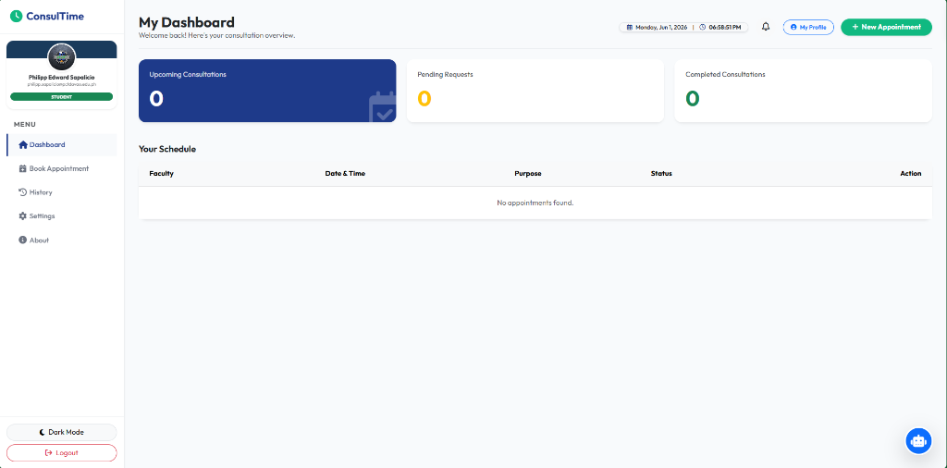
SYSTEM SHOWCASE: STUDENT DASHBOARD
Student view for scheduling and app access
Student Panel Layout
• Upcoming Bookings: Lists active appointment schedules and statuses.
• APK Download: Banners link directly to Capacitor mobile packages.
• Alerts Panel: Shows dynamic responses from instructors.

Slide 12
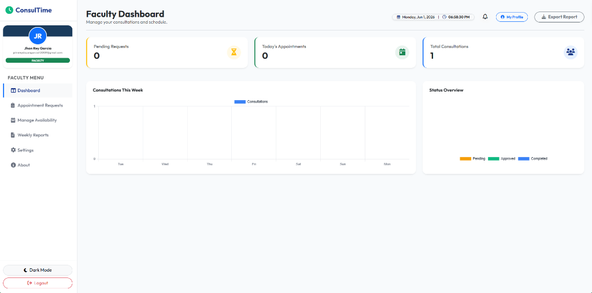
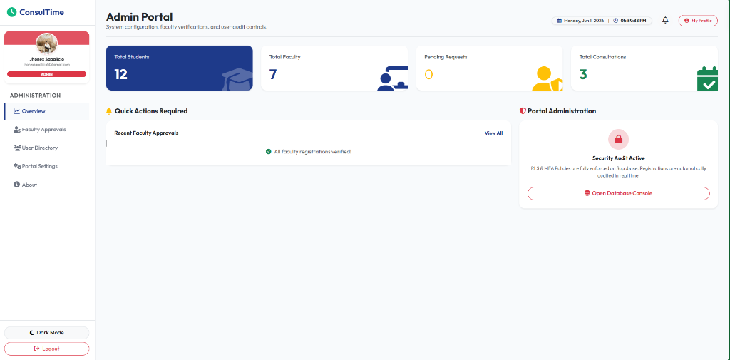
SYSTEM SHOWCASE: FACULTY & ADMIN PORTALS
Governance panels for faculty and admins
Figure 3: Faculty Dashboard. Allows instructors to toggle slots status and approve/reject bookings.
Figure 4: Admin Portal. Unified gateway to approve faculty registrations and monitor server logs.

Slide 13
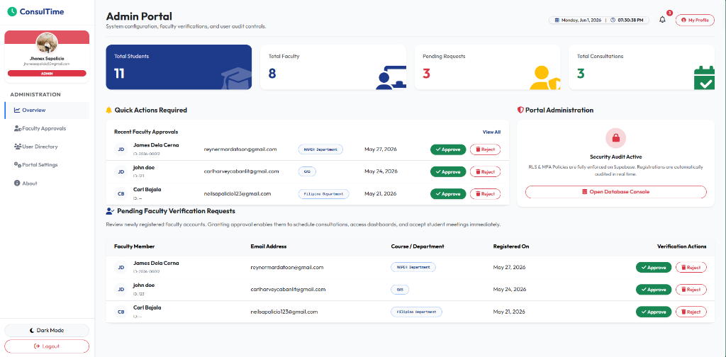
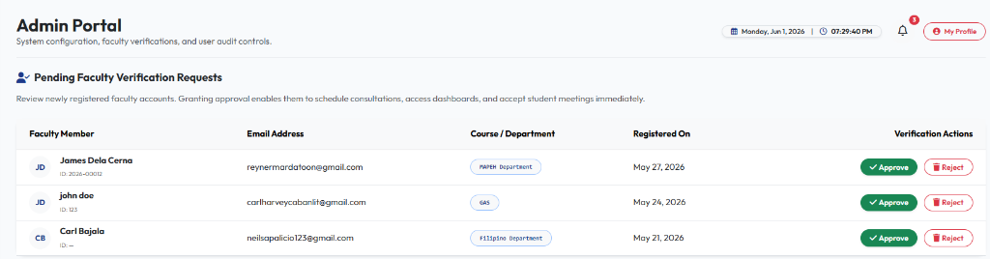
ADMIN CONTROLS & VETTING PIPELINE
Vetting interfaces to verify faculty credentials and monitor server status
Figure 3.1: Admin Dashboard. Shows user statistics and quick actions to manage system state.
Figure 3.2: Faculty Approvals. Admin interface to approve or reject pending faculty registrations.

Slide 14
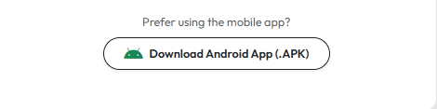
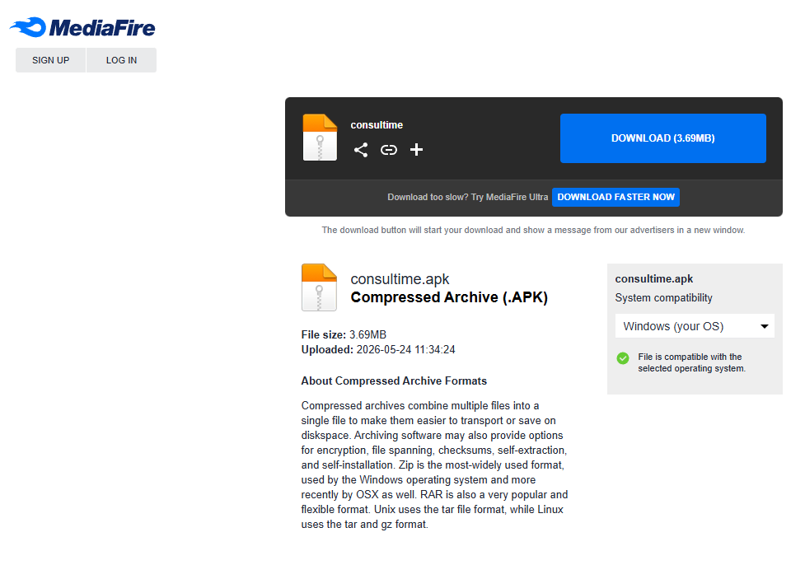
APK MOBILE PACKAGING & DIRECT DOWNLOAD
Capacitor hybrid native wrapper and file server deployment
Why the Mobile App Matters:
• Capacitor Runtime: Compiles web codebase into lightweight native Android APK wrapper package.
• Offline Caching: Service workers preserve layout assets to operate without high mobile bandwidth.
• Bypass App Stores: Direct download button bypasses verification delays for quick campus deployment.
• Budget Device Friendly: 3.69MB package size ensures compatibility with low-end devices (e.g. Vivo Y17s).
Figure 5.1: Direct Android App (.APK) download action button integrated on Login and Register forms.
Figure 5.2: Hosted MediaFire server page distributing compiled direct application package (consultime.apk).

Slide 15
SYSTEM EVALUATION METHODOLOGY
Usability testing framework and focus groups
Testing Standard: ISO/IEC 25010
Focus Group Respondents (N = 26)
• Quality Characteristics: Functionality, Usability, Reliability, Performance Efficiency, Security.
• Survey Tool: Five-point Likert scale questionnaire.
• Analysis: Overall mean and quality interpretations computed.
• Students: 15 active users tested booking and notification flows.
• Faculty Members: 8 instructors verified dynamic availability slots.
• Administrators: 3 personnel tested account registration approvals.

Slide 16
SYSTEM EVALUATION RESULTS
ISO/IEC 25010 Software Quality ratings
ISO/IEC 25010 Evaluation Results Breakdown
Overall Evaluation Mean
4.71 / 5.00
Interpreted as Excellent overall mean score, representing high quality rating.
Quality Characteristic | Mean Rating | Interpretation
Functionality | 4.72 | Excellent
Usability | 4.65 | Excellent
Reliability | 4.69 | Excellent
Performance Efficiency | 4.81 | Excellent
Security | 4.69 | Excellent
Overall Mean | 4.71 | Excellent
Performance Efficiency
4.81 Rating
Highest score among criteria. Users highly satisfied with system speed, loading times, and real-time database updates.

Slide 17
CROSS-DEVICE SCREEN COMPATIBILITY
Viewport responsiveness tests across multiple devices
Device Model | Screen Size / Resolution | Testing OS & Browser | Display Suitability Status
Vivo Y17s | 6.56" (720x1612 px) | Android / Chrome Mobile | PASSED (100% Mobile responsiveness)
Samsung Galaxy S9 | 5.8" (1440x2960 px) | Android / Chrome Mobile | PASSED (100% Mobile touch scale)
iPad Air Pro | 11" (2360x1640 px) | iOS / Chrome Tablet | PASSED (100% Tablet layout double stack)
MSI GF65 Thin | 15.6" (1920x1080 px) | Windows / Chrome Desktop | PASSED (100% Laptop sidebar display)
Desktop Computer | 24" (1920x1080 px) | Windows / Chrome Desktop | PASSED (100% Desktop center bound)

Slide 18
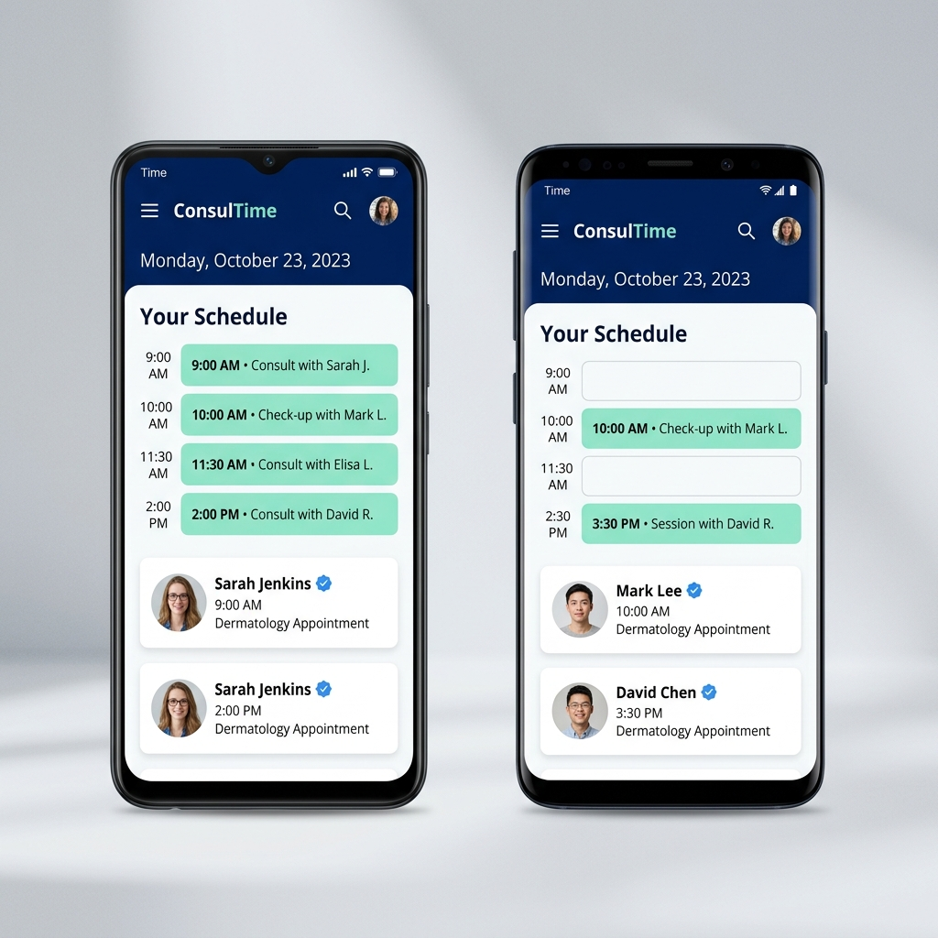
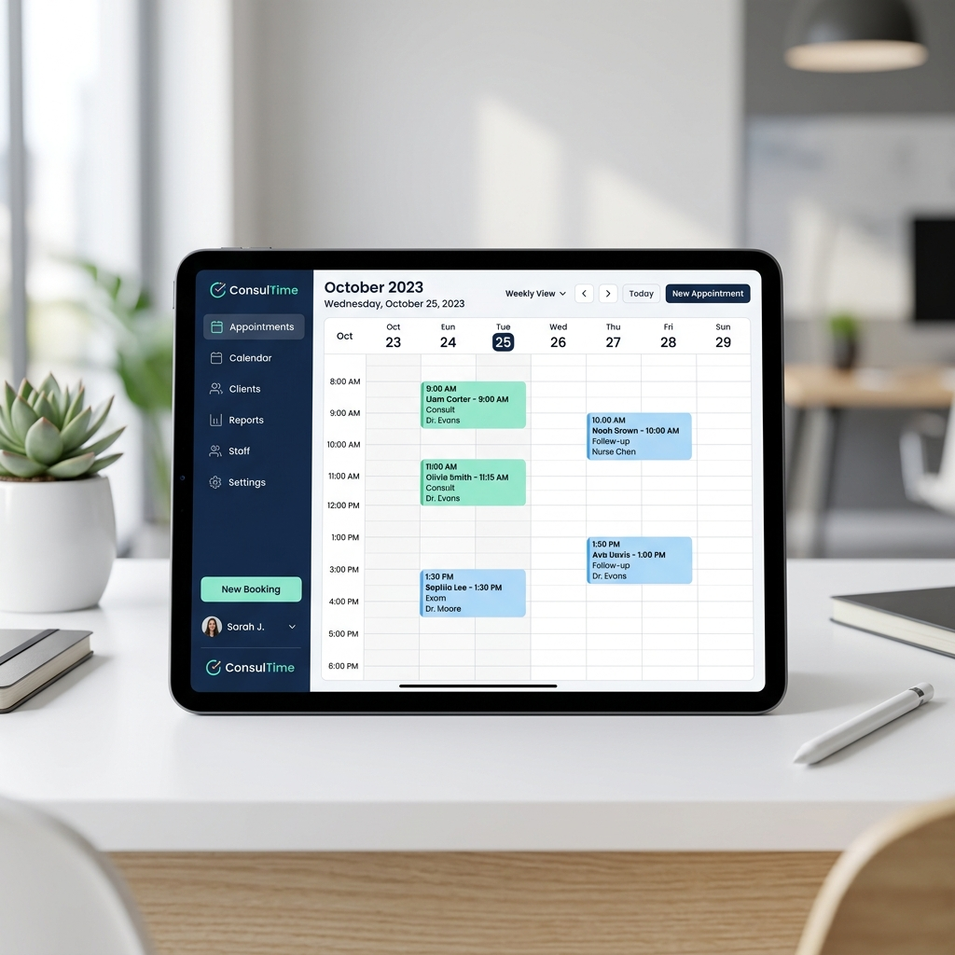
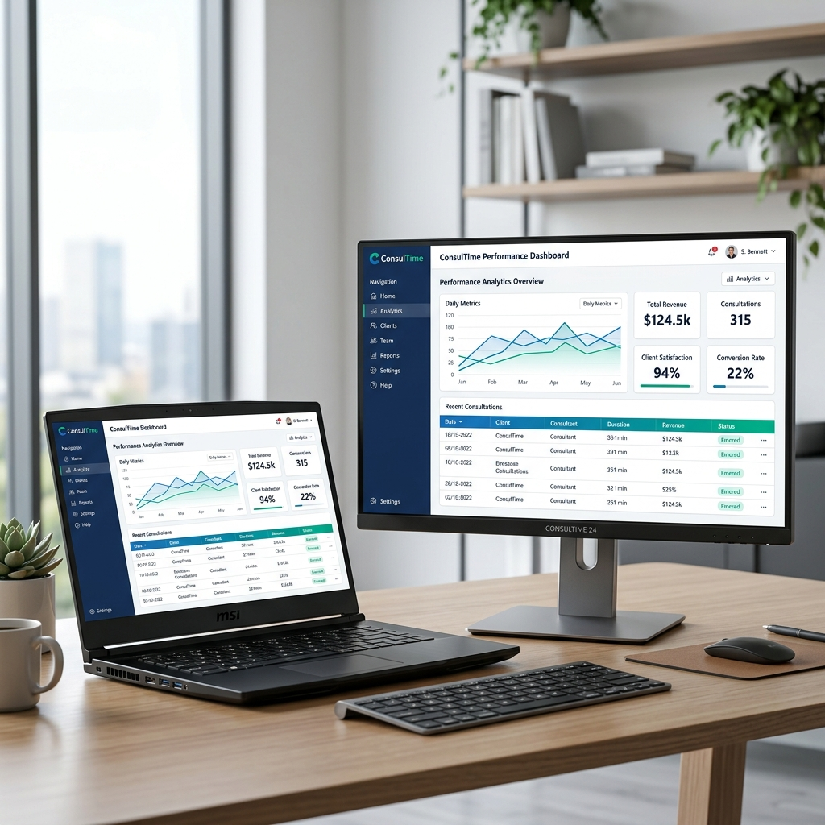
CROSS-DEVICE RESPONSIVENESS MOCKUPS
System layout adapting dynamically across different device viewports
Mobile Viewport. Optimizes touch layouts for small phone screens (e.g. Vivo Y17s & Samsung S9).
Tablet Viewport. Adapts sidebar controls and card grids for medium screens (e.g. iPad Air Pro).
Desktop Viewport. Maximizes display density and full telemetry views for laptop and desktop workstation resolutions.

Slide 19
IMPLICATIONS FOR PRACTICE & RECOMMENDATIONS
Avenues for academic digital transition
Implications for Practice
Recommendations for Future Studies
• Academic Efficiency: Shifting physical appointment grids online removes scheduling conflicts.
• Role Isolation Security: Enforcing strict Row Level Security rules sets a baseline design standard for storing student and advisor logs securely.
• Live Chat Channels: Integrate context-based chatting views adjacent to booking slots.
• Cross-Platform Deployment: Expand Capacitor pipelines to package applications for Apple iOS systems.
• Video Conferences: Embed direct browser video API bridges for remote consultation sessions.

Slide 20
THANK YOU!
ConsulTime: A Cross-Platform Consultation and Appointment Management System
Questions & Recommendations Session
Philipp Edward Sapalicio, Ednell Sapalicio

